Slide 1
Lecture ( 7) LINKAGE CROSS OVER GENETIC MAPS
Dr. Aqeel M. Ali
2019

Slide 2
LINKAGE
Hereditary units ( gene) carried by chromosome
Individual has many genes for determination different characters .
1 chromosome has many genes .
Genes for different characters :
either situated …. In the same chromosome
or …. In different chromosomes
When genes in different chromosomes … characters :
either …. appear together
or …. Appear apart .
( depending on chance, according to Mendel’s law )

Slide 3
LINKAGE
When genes: 1- situated in same . Chrom.
2- fairly close to each
3- inherited together
LINKAGE :
Coexistance of two or more genes in . the same chromosome .

Slide 4
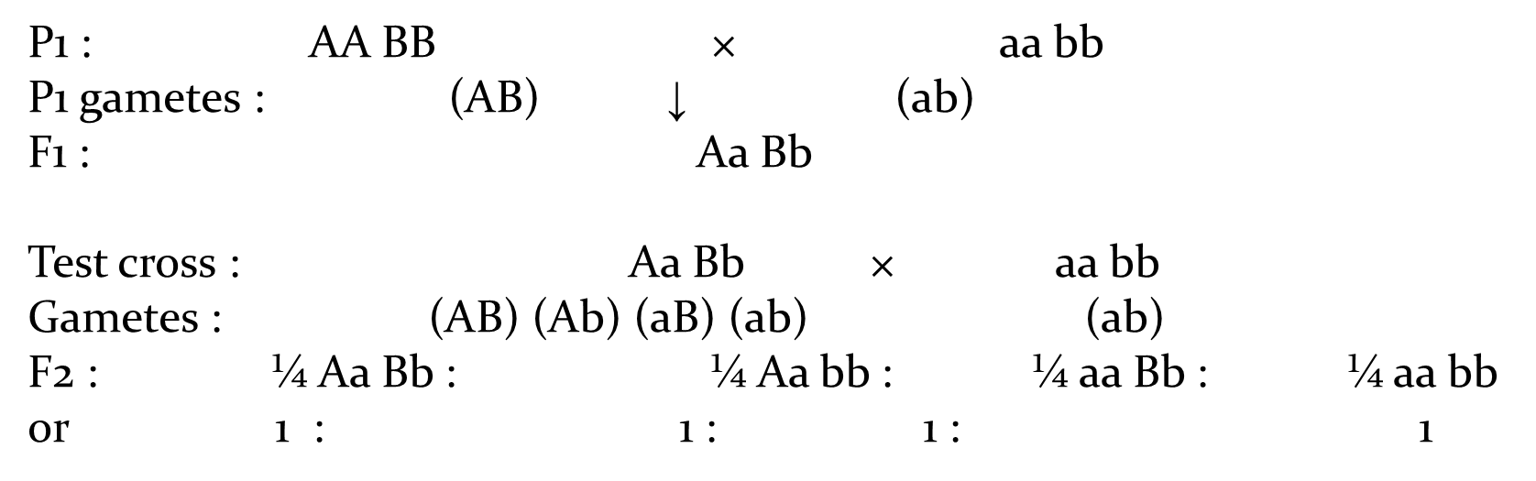
Linkage :

Slide 5
Linkage :
P1 : AB/AB × ab/ab
P1 gametes : (AB) ↓ (ab)
F1 : AB/ab
Test cross : AB/ab × ab/ab
Gametes : (AB) (ab) (ab)
F2 : ½ AB/ab : ½ ab/ab
1 : 1.

Slide 6
Chromosome theory Linkage by Morgan
1- the linked genes situated in same chrom. & remain bounded by chromosomal material ( can’t separated during process of inheritance )
2- the genes are arranged in linear fashion in the chromosome .
3- distance between linked genes determines the strength of linkage
( closely located genes show strong linkage ) . (widely located genes show weak linkage )

Slide 7
Kinds of Linkage
1- complete linkage
* in 2 or moregenerations
* Regular fashion
* i.e. bent wings (bt) & sheven bristles (svn) ch.4 in drosophila melanogaster
2- in complete linkage
The linked genes do not always stay together because homologous non-sister chromatids may exchange segments of varying length with one another during meiotic prophase. This sort of exchange of chromosomal segments in between homologous chromosomes is known as crossing over

Slide 8
Complete linkage in male Drosophila
In most of the organisms crossing-over takes place both in males and females.
But in male Drosophila and female silkworm, crossing-over takes place either very rarely or not at all.
This becomes clear byMorgan’s(1957) experimental results from Drosophila.
In 1919, T.H. Morgan mated gray bodied and vestigial winged(b+vg/b+vg) fruit flies with black bodies and normal long wings (bvg+/bvg+).

Slide 9
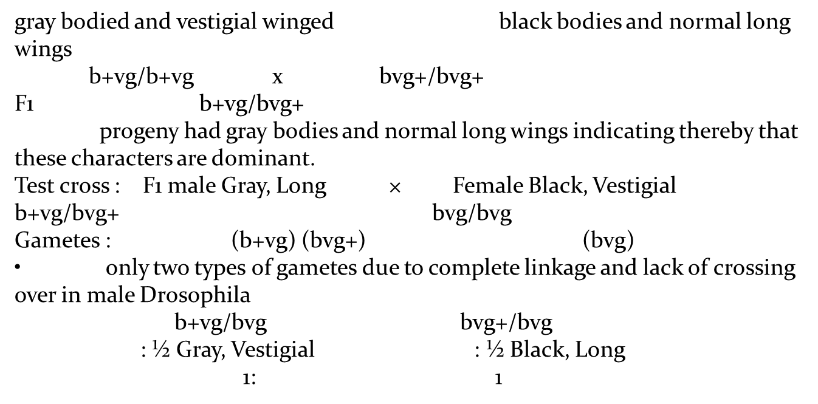
Complete linkage :

Slide 10
Notes
F1 males (b+vg/bvg+), backcrossed (test crossed)
to double recessive females (bvg/bvg or black vestigial).
only two types of progeny (gray bodies and vestigial wings, b+vg/bvg ) and (black bodies and normal wings, bvg+/bvg) instead of four types of phenotypes .
Use of the testcross is very important. Because one parent (the tester) contributes gametes carrying only recessive alleles, the phenotypes of the offspring represent the gametic contribution of the other double heterozygote parent. So the genetical analyst can concentrate on one meiosis and forget the other. This is in contrast to the situation in an F1 where there are two sets of meiotic divisions to consider one for the F1 male parental gametes and one for the F1 female.

Slide 11
Test cross ratio :
1- Gray, Vestigial; b+vg/bvg = 41.5%
83% parental combination
2- Black, Long; bvg+/bvg = 41.5% showing linkage
3- Gray, Long ; b+vg+/bvg = 8.5% 17% recombinant
4- Black, Vestigial; bvg/bvg = 8.5% crossing over

Slide 12
Incomplete linkage in female Drosophila
Morgan’s classical cross in Drosophila between gray, vestigial (b+vg/b+vg) and black, normal or long (bvg+/bvg+) were testcrossed to double-recessive (bvg/bvg) males, all four types of progeny were obtained in following ratio, showing the occurrence of crossing-over
Parents : Gray, Vestigial × Black, Long
b+vg/b+vg bvg+/bvg+
Gametes : (b+vg) (bvg+)
F1 : b+vg/bvg+ Gray, Long
Test cross : F1 Female Gray, Long × Male Black, Vestigial
b+vg/bvg+ bvg/bvg
↓
Game tes : (b+vg) (bvg+) = Non-cross overs (bvg)
(b+vg+) (bvg) = Recombinants

Slide 13
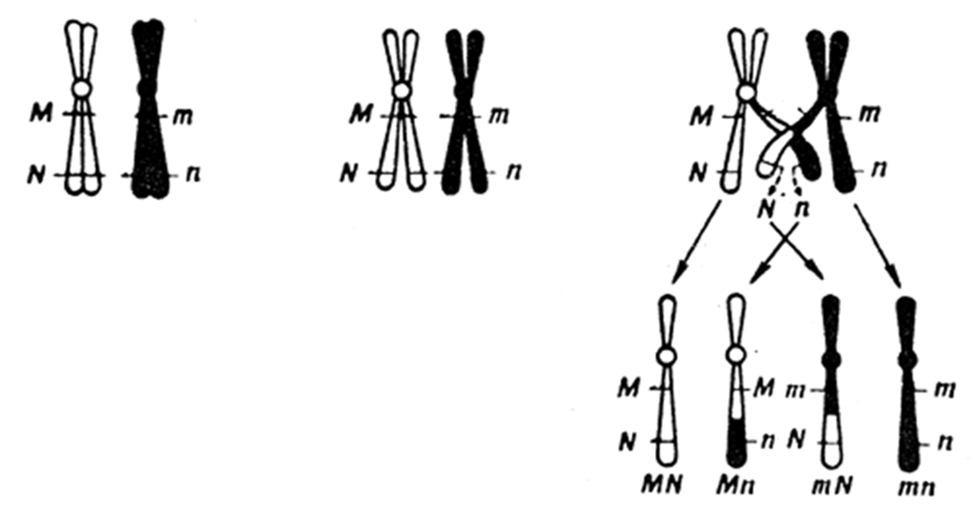
Crossover between chromatids of a pair of homologous chromosomes

Slide 14
Linkage groups
Drosophila 4 pairs = 4 linkage group
Man 23 pairs = 23 linkage group
Corn 10 pairs = 10 linkage group

Slide 15
Notes :
1. Female human = 22 pairs autosomes + 1 pair of : X chromosomes
= 22 autosomal linkage groups + 1 X chromosomal linkage group
= 23 linkage groups.
2-Male human : = 22 pairs of autosomes + X + Y chromosomes
= 22autosomal linkage group + 1 X linkage group + 1 Y linkage group . = 24 linkage groups.
SIGNIFICANCE OF LINKAGE
One of the great significance for the living organisms that
“ reduces the possibility of variability in
gametes unless crossing over occurs”

